Slide 1
Building Solutions for Teams and SPO with SharePoint Framework
Shantha Kumar T
@ktskumar

Slide 2



AGENDA
SharePoint Framework
Teams Client SDK
MS Teams & APPS
SP API & Graph API
Posting and Deep Linking
Q & A

Slide 3

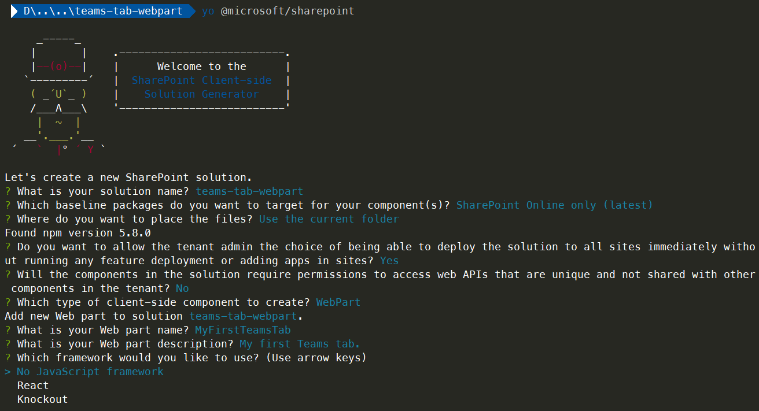
SharePoint Framework

Slide 4
SHAREPOINT Fx OVERVIEW
Node JS
NPM
Web Parts
GULP
Yeoman
Typescript
Extensions
Visual Studio Code
Command Line

Slide 5
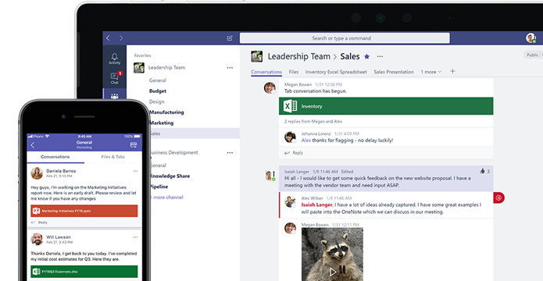
MS Teams

Slide 6





ARCHITECTURE
MS TEAMS
ONE DRIVE FOR BUSINESS
SHAREPOINT ONLINE
EXCHANGE ONLINE
MS PLANNER
MS STREAM
YAMMER

Slide 7
TEAMS CLIENT SDK
MS TEAMS
SPFx handles authentication
GETS Teams context information
GETS Deep Link Parameters
GETS Tab instances owned by app
Handle Messages

Slide 8
Architecture
Apps for Teams

Slide 9




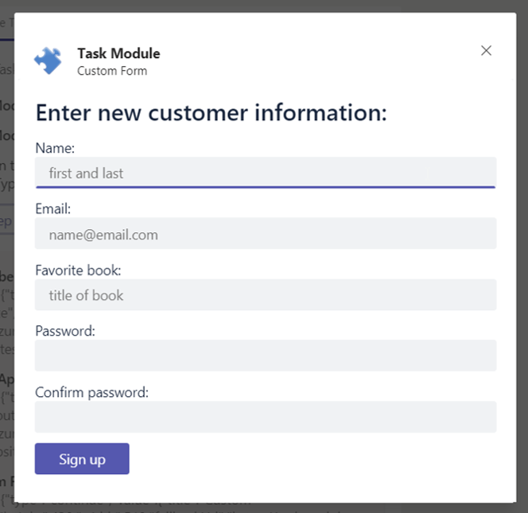
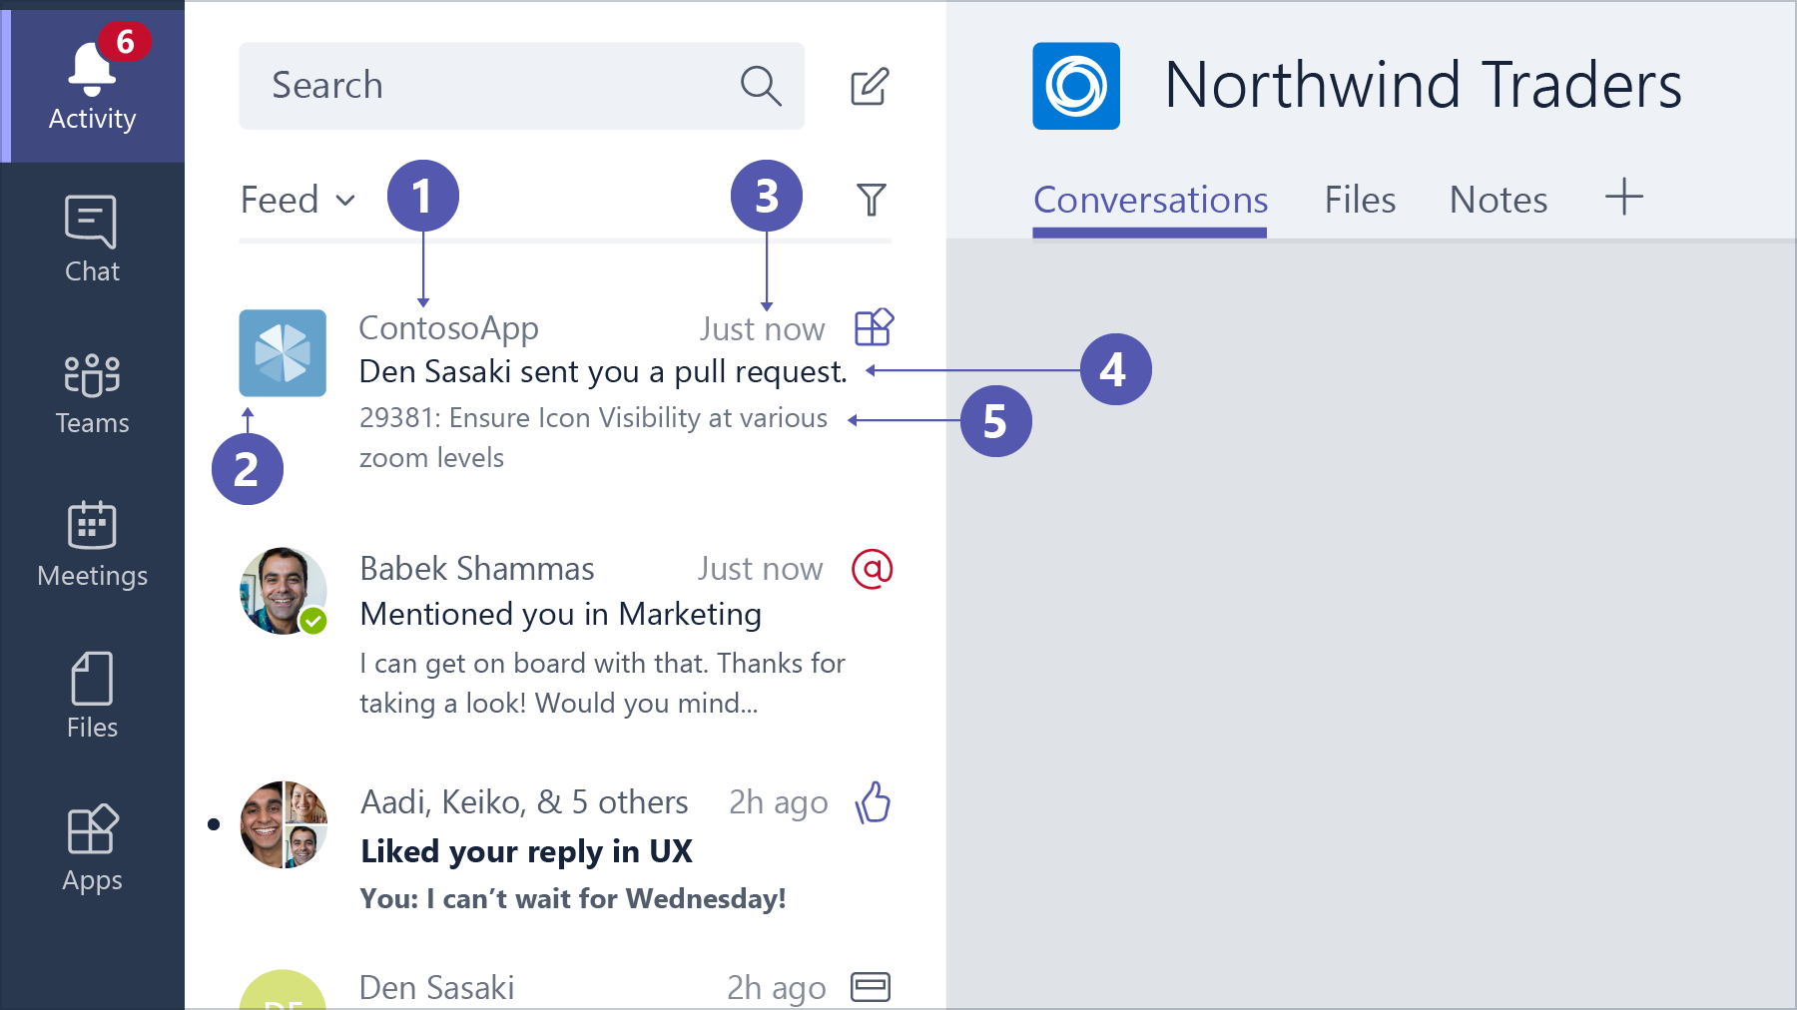

APPS FOR MICROSOFT TEAMS
TABS
BOTS
MESSAGE EXTENSIONS
OUTGOING WEB HOOKS
ACTIVITY FEED INTEGRATION
TASK MODULES
CONNECTORS

Slide 10

APPS FOR MICROSOFT TEAMS
WEB APPS
SUPPORTS ANY WEB-PROGRAMMING TECHNOLOGY
RUNS ON ANY PLATFORM
MANIFEST (.json), TWO ICONS 32 x 32 PNG, 192 x 192 PNG
App Package
(.zip)
INSTALL INTO TEAMS
PUBLISH ON APP SOURCE

Slide 11
SPFX – WEBPART & TEAMS TAB
WEBP PARTS
SPFx SOLUTION (.sppkg)
SHAREPOINT ONLINE
APP CATALOG SITE OR STORE
SHAREPOINT FRAMEWORK
TABS ( TEAM or PERSONAL) – Hosted in SharePoint
TEAMS APP (.zip)
MS TEAMS
TEAMS OR STORE

Slide 12
Demo – Teams Client SDK
Get Context in SPFx WebPart

Slide 13
TEAM CLIENT SDK
SPFx handles authentication
GETS Teams context information
GETS Deep Link Parameters
GETS Tab instances owned by app
Handle Messages

Slide 14
Demo – SharePoint API
Access SharePoint data

Slide 15
Demo – Graph API
Access Microsoft 365 data

Slide 16
Demo – Post and Deep link
Adding conversation and Deep Linking

Slide 17
TOP ADVANTAGES
Host a page in SharePoint
Reuse code in Teams and SharePoint
Built-in Azure AD Single sign-on
SharePoint handles the configuration page
Team SDK tells the current Team, Channel
Easy access to Microsoft Graph API
Store date in the Office 365 group
Manage app centrally in Sharepoint Admin Center
Deep linking allows passing context

Slide 18

Enjoy the Bootcamp

Slide 19

Call to action
Share your feedback on Bootcamp at https://aka.ms/Microsoft365DevBootcampSurvey2019
Join Office 365 developer program https://dev.office.com/devprogram to leverage all resources for Office 365 development learning
Build applications on Office 365 platform
Attend MVP led local community events to continue learning on Office 365 development

